Slide 1

Cis 404 Capstone project
Musawir Mehfuz

Slide 2
Project outline
INTRODUCTION
SDLC
DESIGN ALGORITHM
OUTPUT
JIRA IMPLEMENTATION

Slide 3
Introduction
Good afternoon class Today I will be going over a project I worked on which lets the user enter a number and then the user will have to guess two numbers that is the sum.

Slide 4


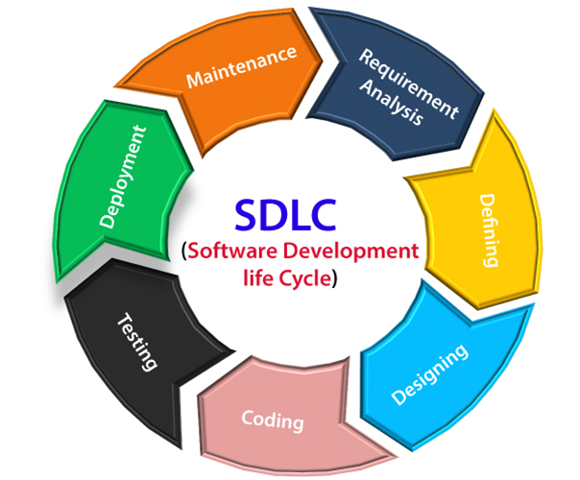

SDLC

Slide 5

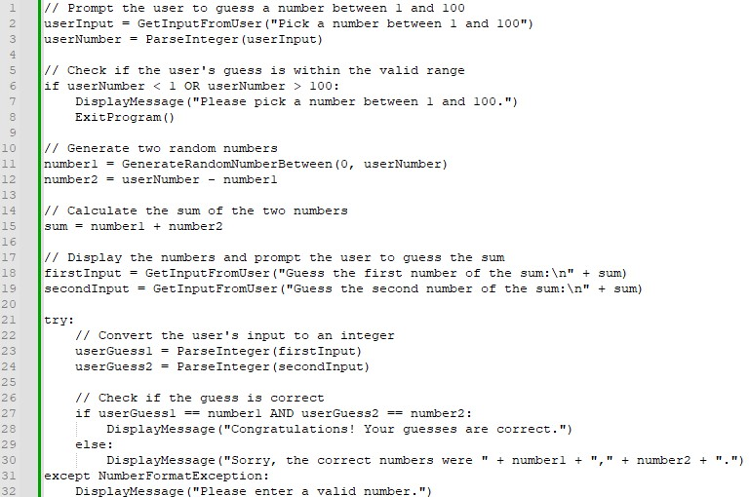
Design Algorithm

Slide 6
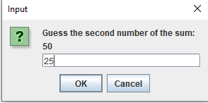
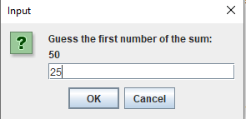
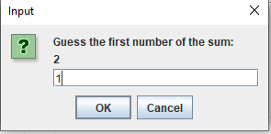
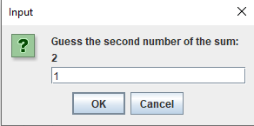
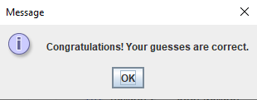
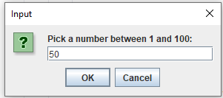
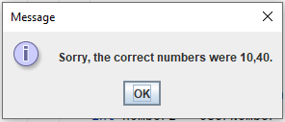
PROJECT OUTPUT
Fail
Pass

Slide 7
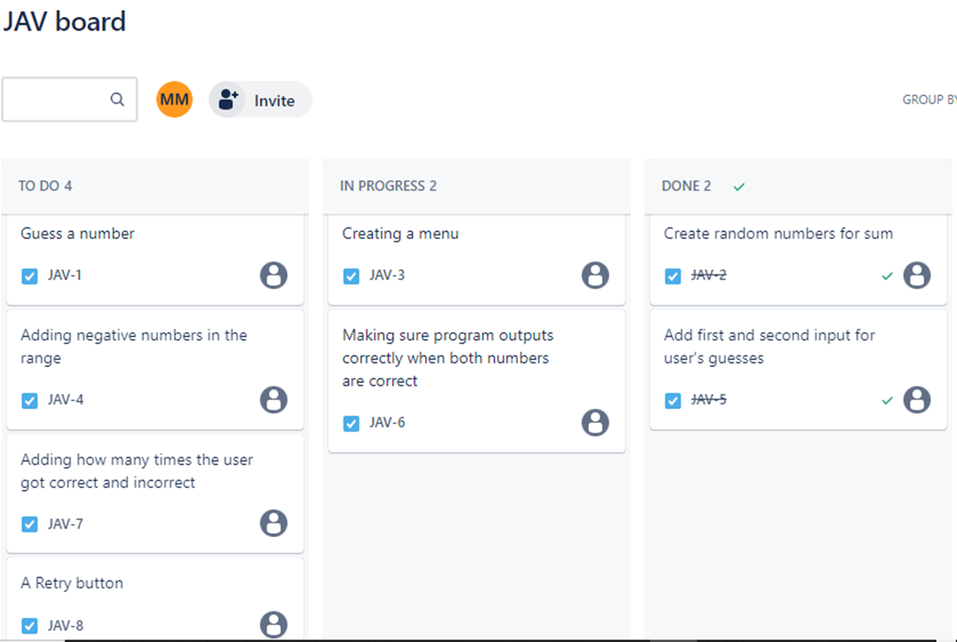
Jira implementation

Slide 8

Thank You!
Here is my LinkedIn: www.linkedin.com/in/mmehfuz7

